Slide 1
Task Management Application
CS 212 Group Project
Team Members:
1. Javier Rojas Garcia
2. Maya Harvey

Slide 2

Agenda
01
Problem Statement & Idea
02
Project Components
03
Phase - 1 and Phase - 2 Deliverables
04
Challenges and Solutions
05
Project Demo

Slide 3
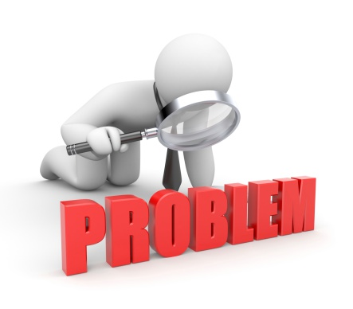
Problem Statement & Idea
People often struggle to keep track of their tasks and to-dos. A simple task management application can help users organize, prioritize, and track their tasks efficiently.
Create a tasks management application using HTML, CSS, and JavaScript. The application will allow users to organize and track their tasks in an intuitive and user-friendly interface

Slide 4

Project Components
Create, Read, Update, Delete Tasks | Enable users to create new tasks with details like title, description, due date, and priority using forms. Display a list of tasks in the dashboard in the form of cards. Allow users to edit and update task details directly in the dashboard. Provide the option to delete tasks accordingly.
Mark Tasks as Complete | Provide an option for users to mark tasks as completed with a button. Visually distinguish between completed and pending tasks using CSS styles.
Search Tasks | Implement search functionality to allow users to quickly find tasks based on keywords. Use JavaScript to filter and display the tasks that match the search criteria.
Sort Tasks | Enable users to sort pending tasks based on the due date & priority.
Basic Dashboard with Task Statistics | Display a simple dashboard showing statistics such as the total number of tasks, completed tasks, and pending tasks. Update the statistics dynamically as tasks are added, edited, or deleted.

Slide 5
Phase – 1 Deliverables
Create, Read, Update, Delete (CRUD) Tasks
Mark Tasks as Completed
Enable users to create new tasks with details like title, description, due date, and priority using forms.
Display a list of tasks in the dashboard in the form of cards.
Allow users to edit and update task details directly in the dashboard.
Provide the option to delete tasks accordingly.
Provide an option for users to mark tasks as completed with a button.
Visually distinguish between completed and pending tasks using CSS styles.

Slide 6
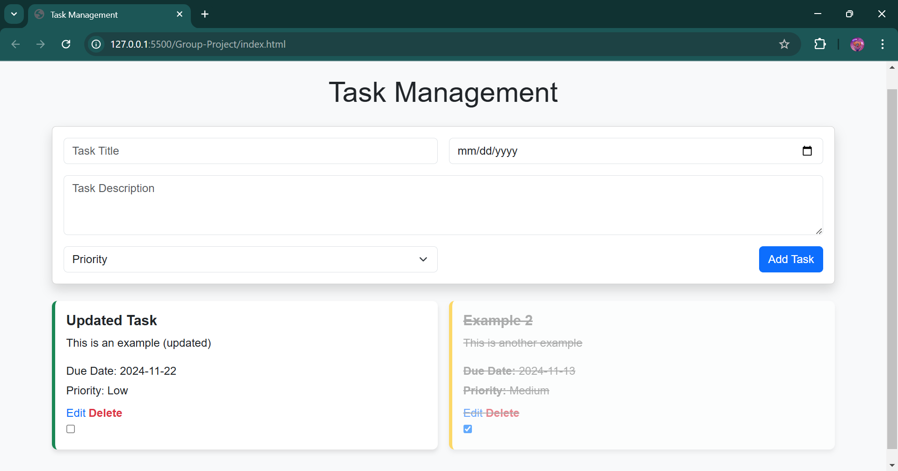
Phase – 1 Deliverables Contd.
Form to create tasks
Task Card with Edit and Delete Buttons
Task Card with visual distinction showing it’s completed

Slide 7
Phase – 2 Deliverables
Search Tasks
Implement search functionality to allow users to quickly find tasks based on keywords.
Use JavaScript to filter and display the tasks that match the search criteria.
Basic Dashboard with Task Statistics
Display a simple dashboard showing statistics such as the total number of tasks, completed tasks, and pending tasks.
Update the statistics dynamically as tasks are added, edited, or deleted.
Sort Tasks
Enable users to sort pending tasks based on the due date & priority.

Slide 8
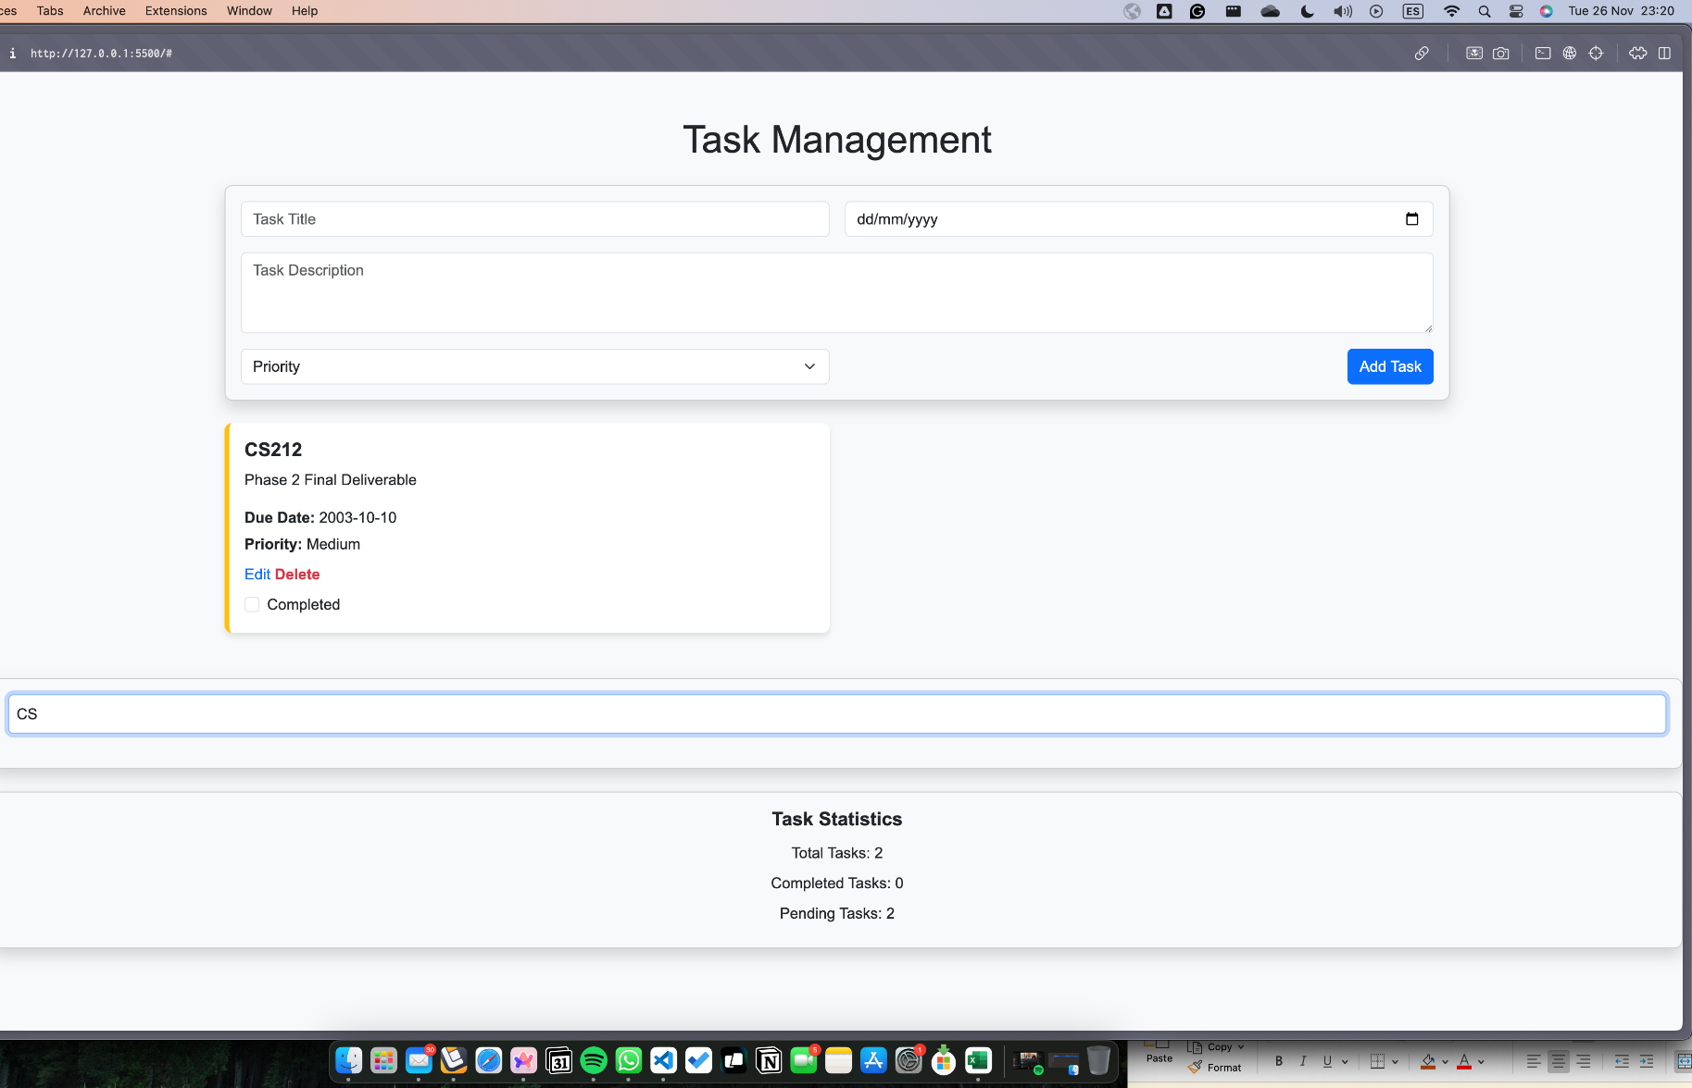
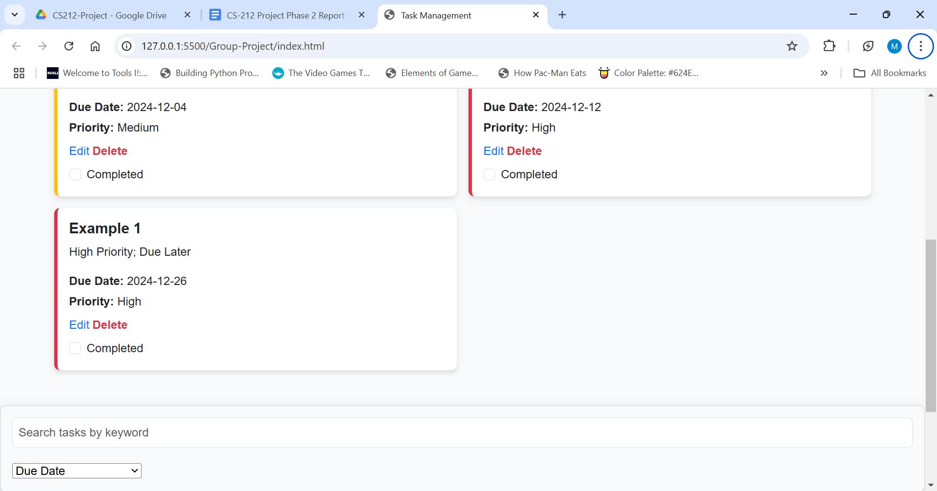
Phase – 2 Deliverables Contd.
Search feature
Task Statistics Dashboard
Sorting Feature

Slide 9
Challenges & Solutions
Difficulty in aligning the design with the mock-up, especially ensuring the responsiveness of the form and task cards.
Utilized the Bootstrap Grid System (row, col-md-*) to create a flexible and responsive layout.
When editing a task for the second time, filling the form with updated task information rather than it being filled with the original contents.
Create two variables, one holding the original content and another holding the updated content. Update the original content with the updated content each time a task is edited.
Managing dynamic additions and deletions of tasks while maintaining a consistent UI.
Implemented JavaScript functions to dynamically create and remove task cards. Used Bootstrap classes for consistent styling and ensured tasks were removed cleanly from the DOM.

Slide 10
Challenges & Solutions Contd.
When making the sorting feature, unsure of how to make an event listener for the dropdown option.
Assigned a value to each of the options provided, and added a listener to the dropdown if it was changed, and made an if statement depending on the value of what it was changed to.
Complexity in updating the sorting logic to handle multiple criteria due date and priority and ensuring user interface
Enhance the sorting function to compare tasks based on due date first, and if dates are equal, compare by priority.

Slide 11

Project Demonstration

